Slide 1
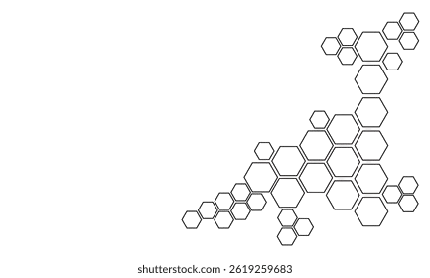
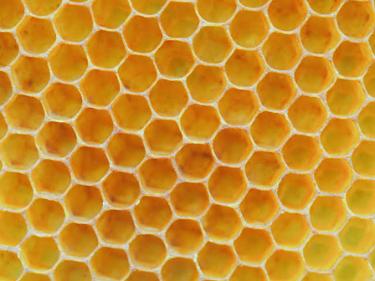
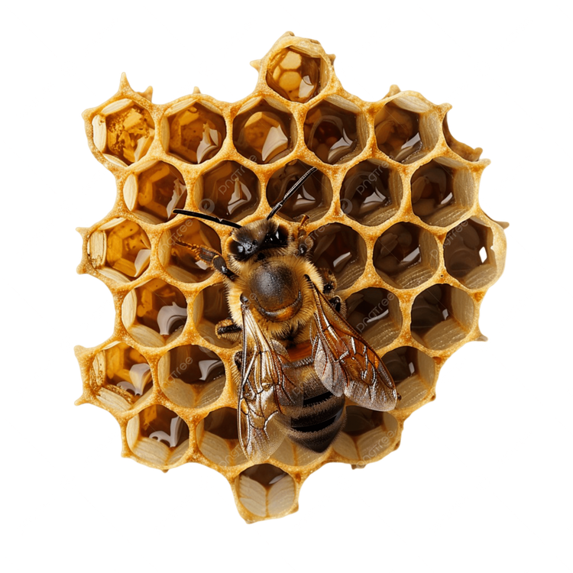
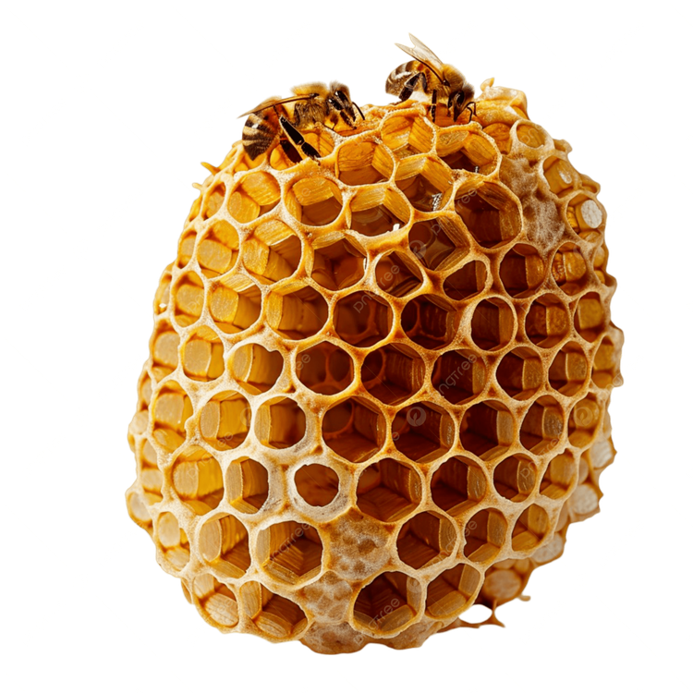
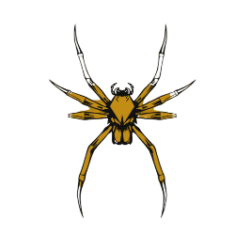
Honeycomb Structures
& Spider-Web Inspired Structures/Buildings
Abantika Nandi C328
Srija Nandi C329
Tvisha Mehta C310 Khushaal Naik C325

Slide 2
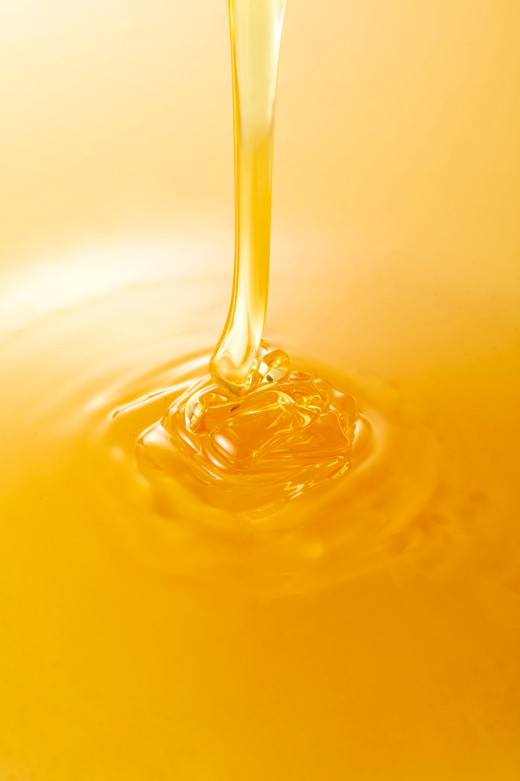

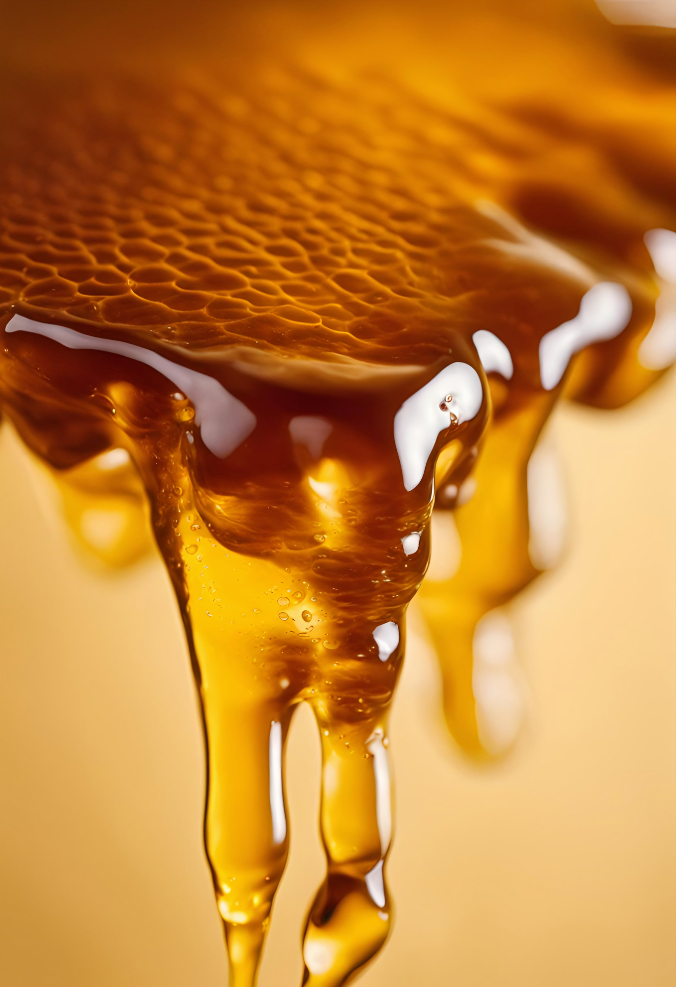
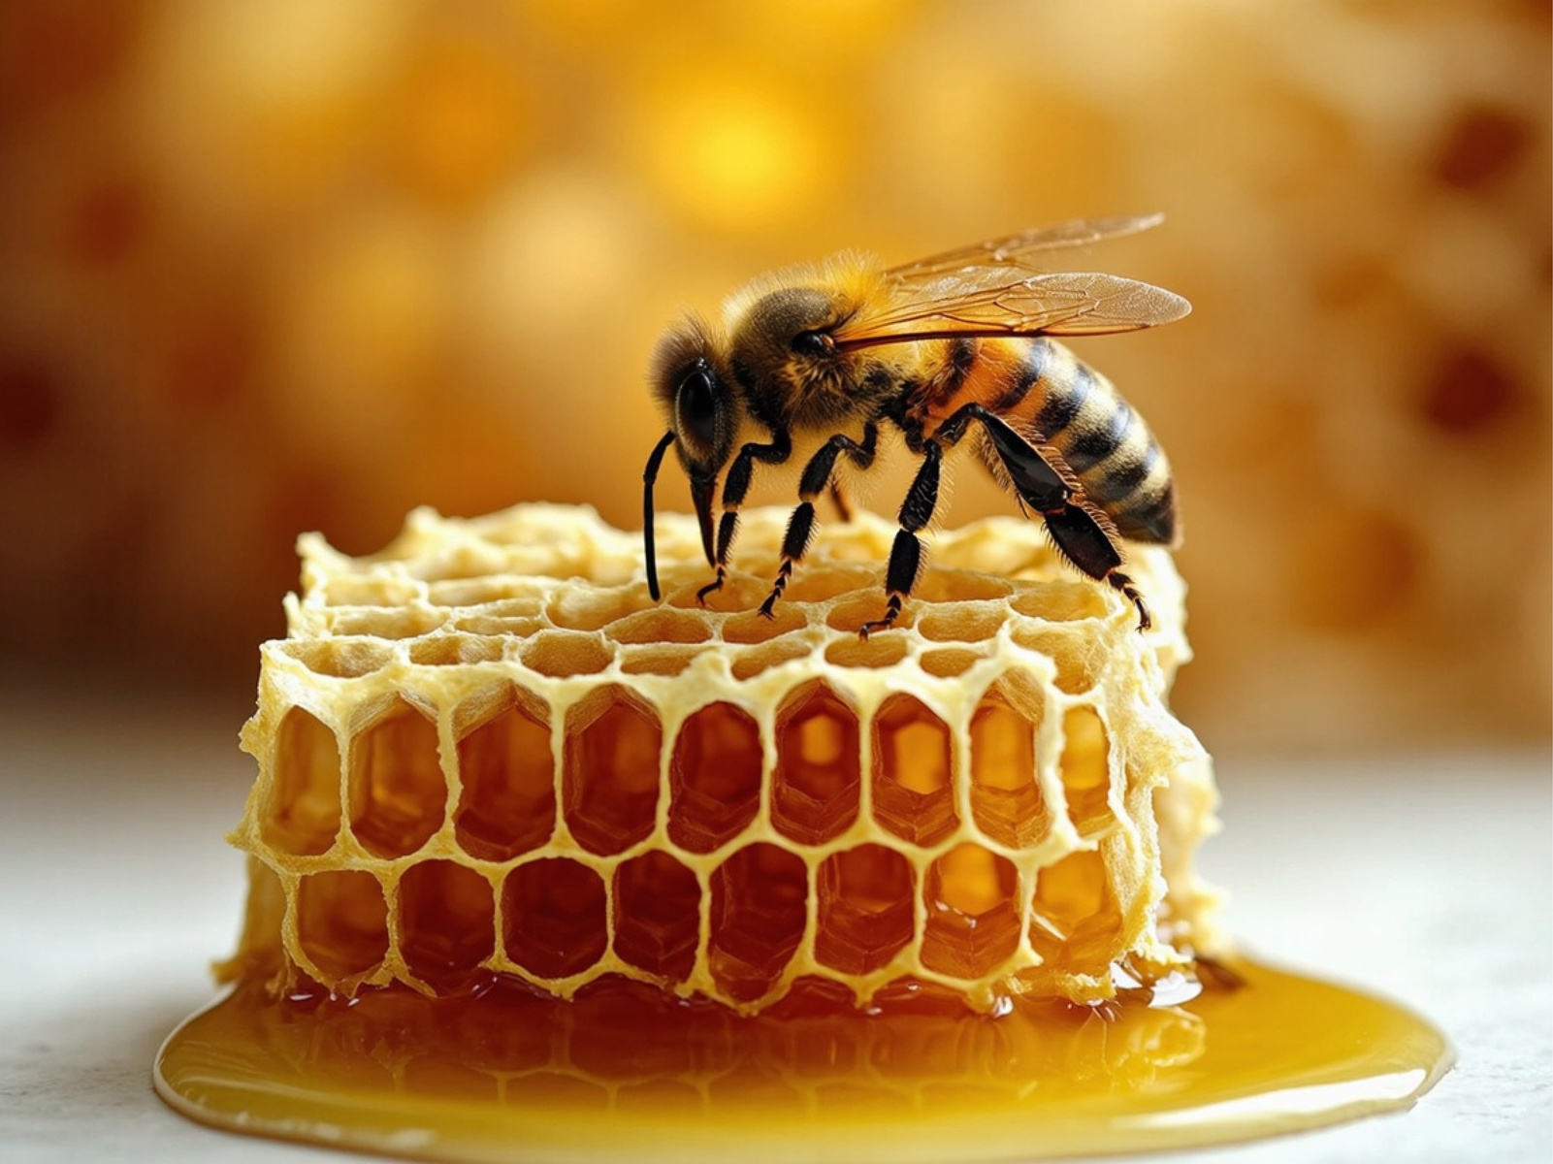
HONEYCOMB
STRUCTURES

Slide 3
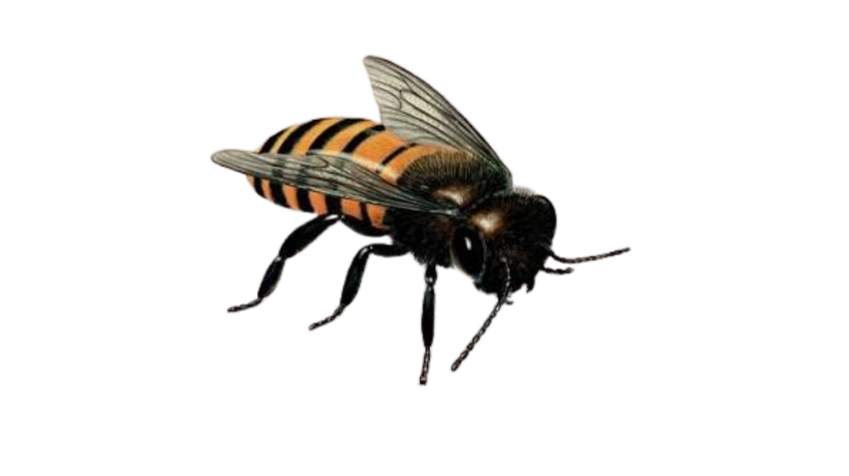
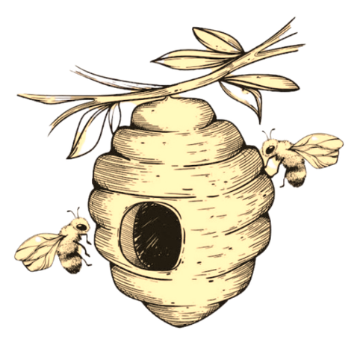



Problem Statement
The engineering challenge :
Conventional building and structural materials often face challenges in balancing strength, lightweight design, material efficiency, and resistance to impact. These limitations can increase construction costs, material consumption, and structural vulnerability.
NATURE SOLVED THIS ALREADY
Excessive Structural Weight: Conventional solid construction components can require substantial material, increasing dead load and the load transferred to beams, columns, and foundations.
Honeycomb-inspired structures mimic the natural hexagonal patterns found in beehives to develop lightweight yet strong designs that distribute loads efficiently, absorb energy, and reduce material usage.
Material Inefficiency: Using more material than necessary can increase resource consumption, transportation requirements, and construction costs.
This project looks at how honey bees optimise these structures for improved strength, stability, durability, and sustainability in modern construction.
Resistance to Impact and Deformation: Some conventional panels lack efficient energy-absorbing mechanisms, making it important to explore structures that can deform in a controlled manner under impact.

Slide 4
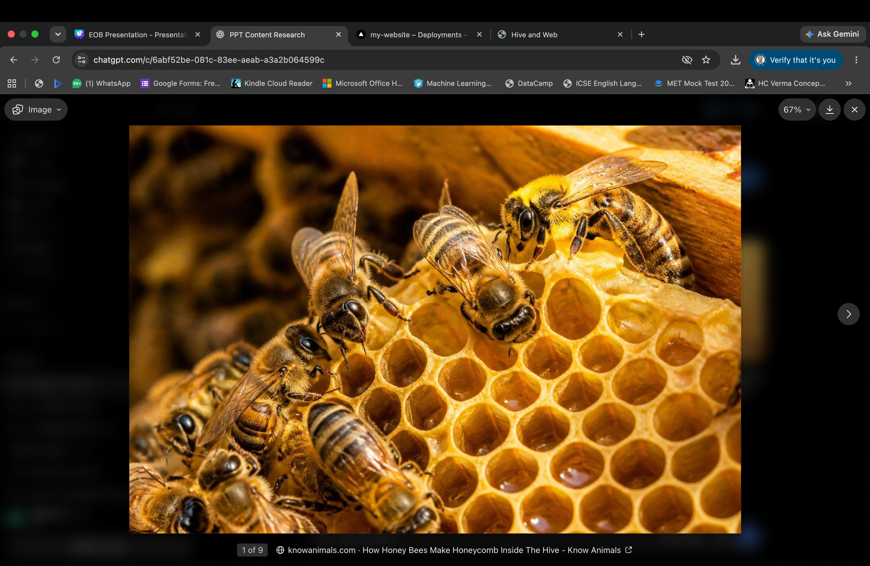
Biological Phenomenon
Honeycomb-inspired structures imitate the hexagonal cells found in beehives to create building components that are lightweight, strong, material-efficient, and capable of absorbing impact energy.
How does the phenomenon occur?
Wax production: Worker bees produce beeswax from specialised glands on their bodies.
Cell construction: Bees manipulate the wax to form adjoining cells, creating a repeating cellular structure within the hive.

Slide 5
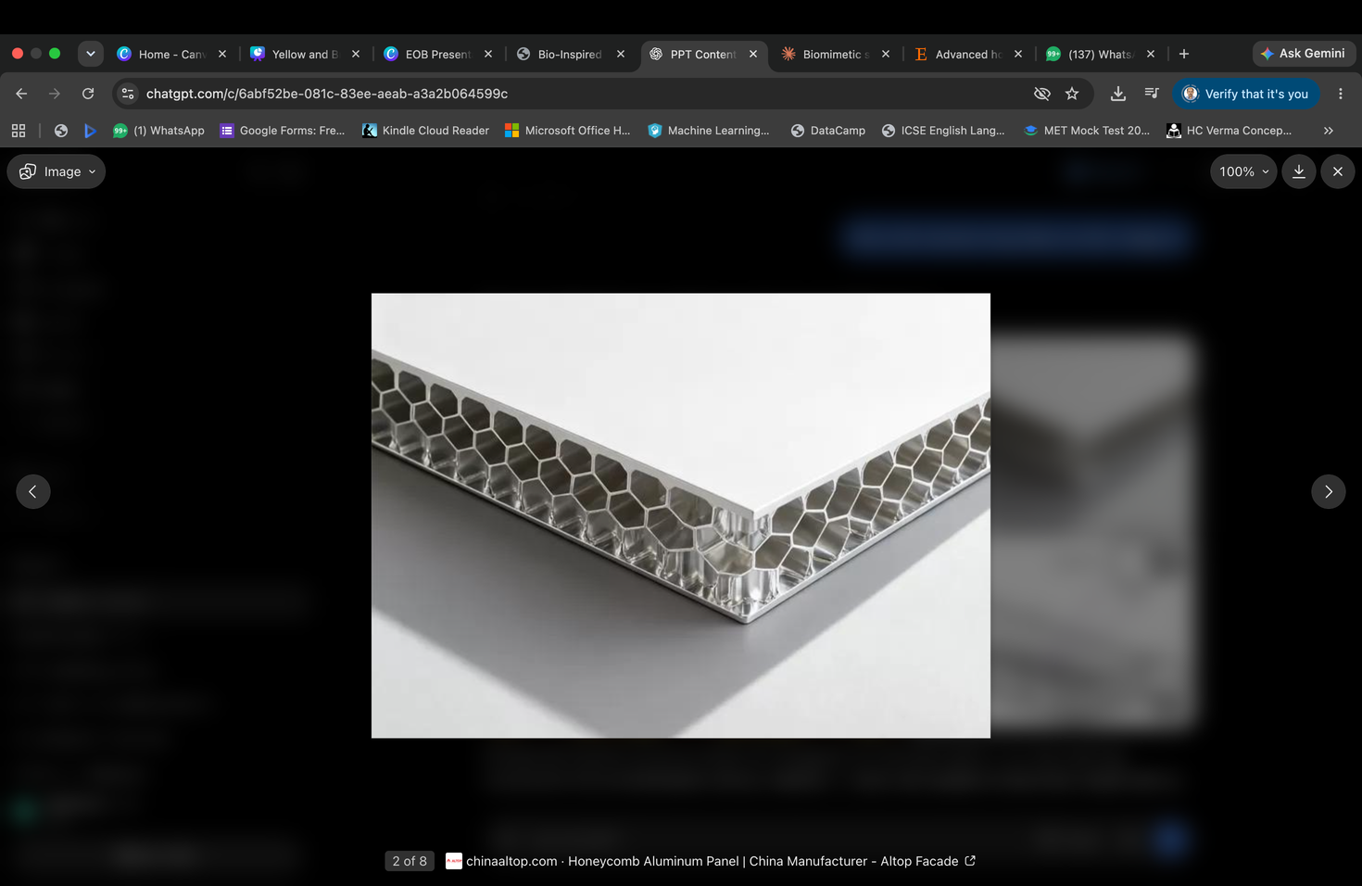
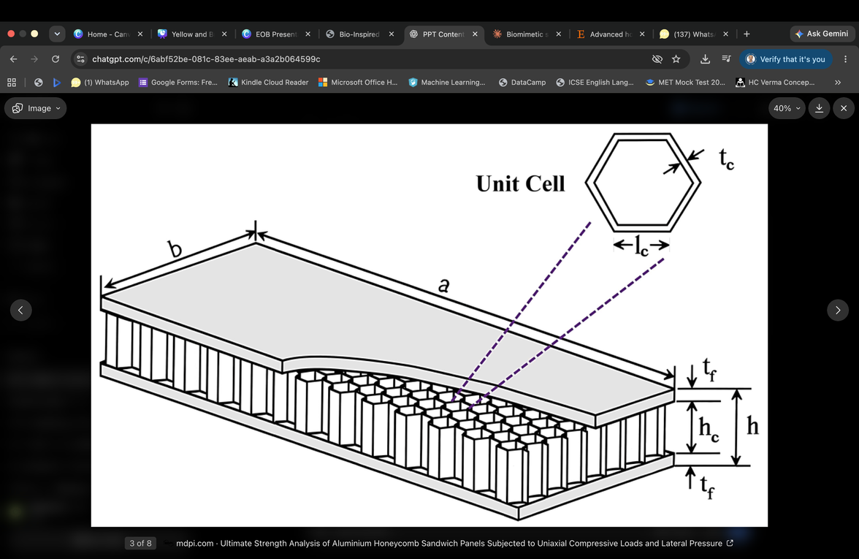
Structural Significance
Honeycomb-inspired structures imitate the hexagonal cells found in beehives to create building components that are lightweight, strong, material-efficient, and capable of absorbing impact energy.
Fig: Honeycomb structure
Fig: Energy Absorption
1.
High strength-to-weight ratio: Hexagonal cells provide structural
stiffness without requiring large amounts of material.
Why are
hexagons used?
2.
Material efficiency: Hexagons fit together without gaps, thus allowing
a continuous structure with minimal wasted space.
3.
Energy absorption: Cell walls can deform under impact and absorb
energy, making honeycomb cores useful in protective panels.

Slide 6

Understanding Honeycomb Structures

Slide 7
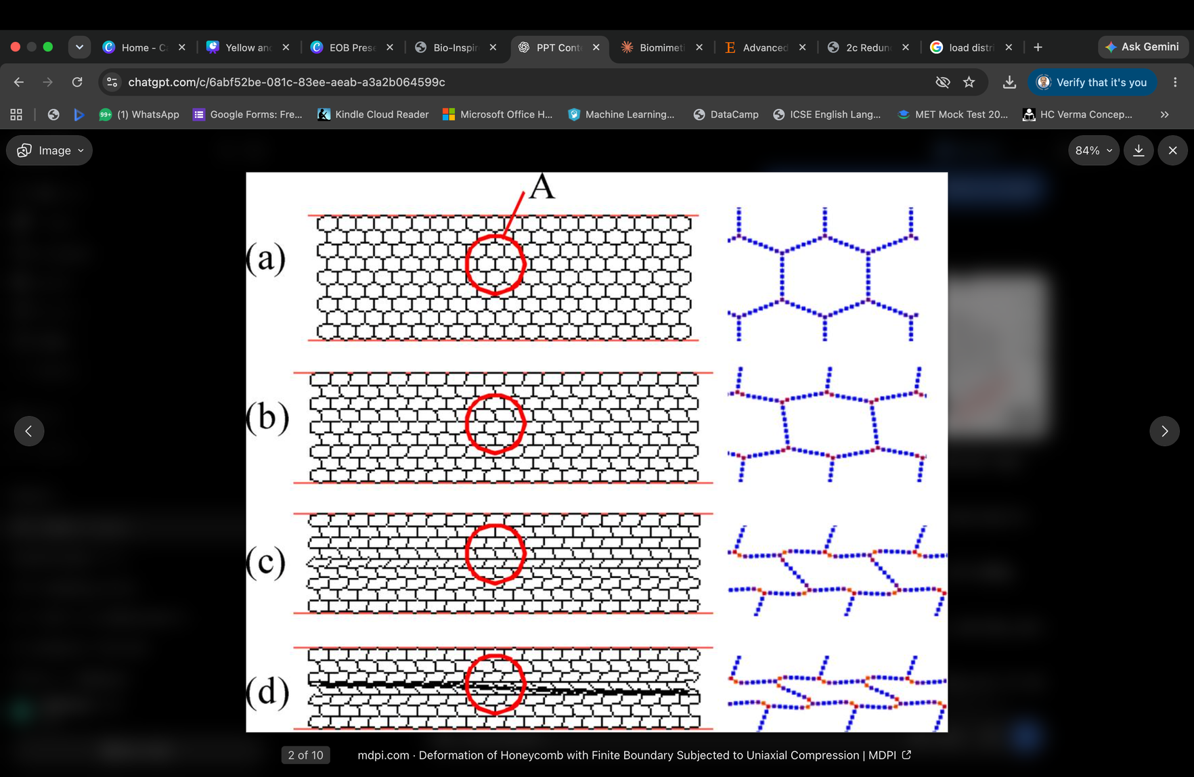
Mechanism
1. Load Distribution
When an external force, such as the weight of a roof or a load on a wall panel, acts on a honeycomb structure, the force is transferred through its interconnected cell walls.
2. Resistance to Deformation
The walls of the hexagonal cells resist deformation through bending, stretching, and compression. The interconnected geometry helps the structure maintain its shape under suitable loading conditions.
Fig:Load Bearing Structure

Slide 8
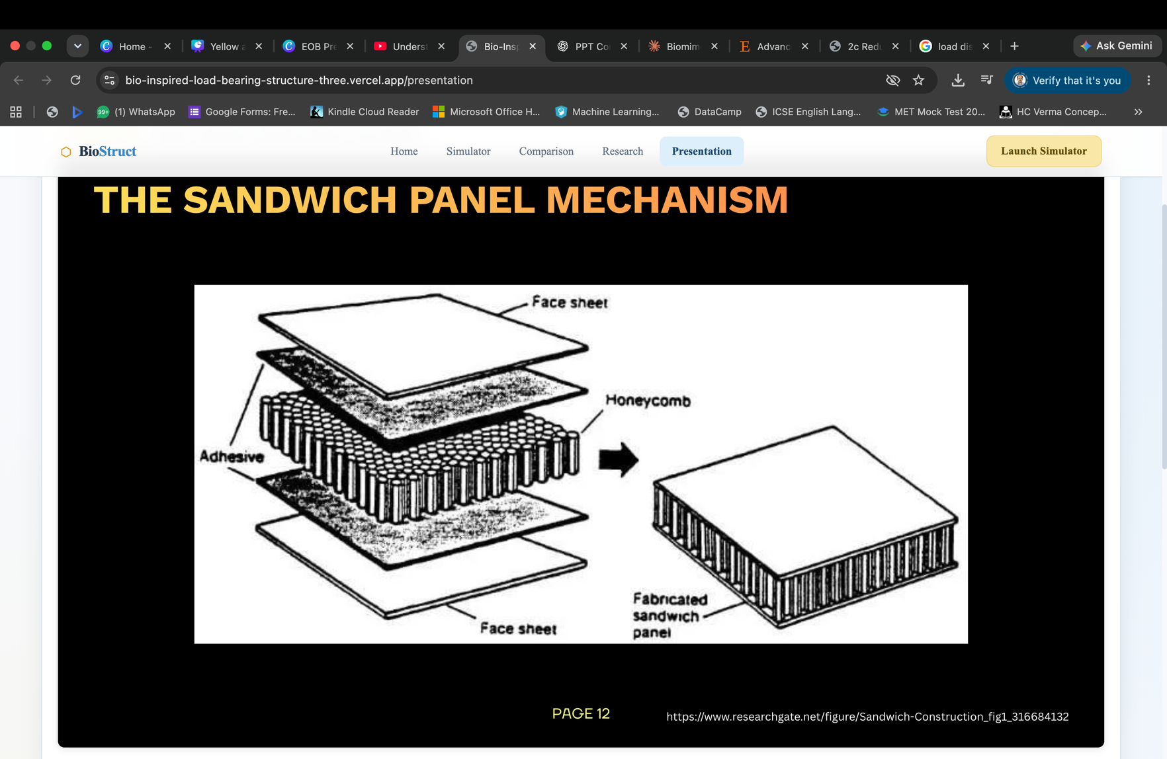
Sandwich Panel Mechanism
Top and bottom face sheets:
The outer sheets are usually made from aluminium. They carry most of the tensile and compressive stresses generated when the panel bends.
Honeycomb core:
It separates the two face sheets, transfers shear forces between them, and helps prevent local deformation of the outer sheets.
Adhesive layer:
A bonding layer connects the face sheets to the honeycomb core. It transfers forces between these components so that they behave as one integrated structural unit.

Slide 9
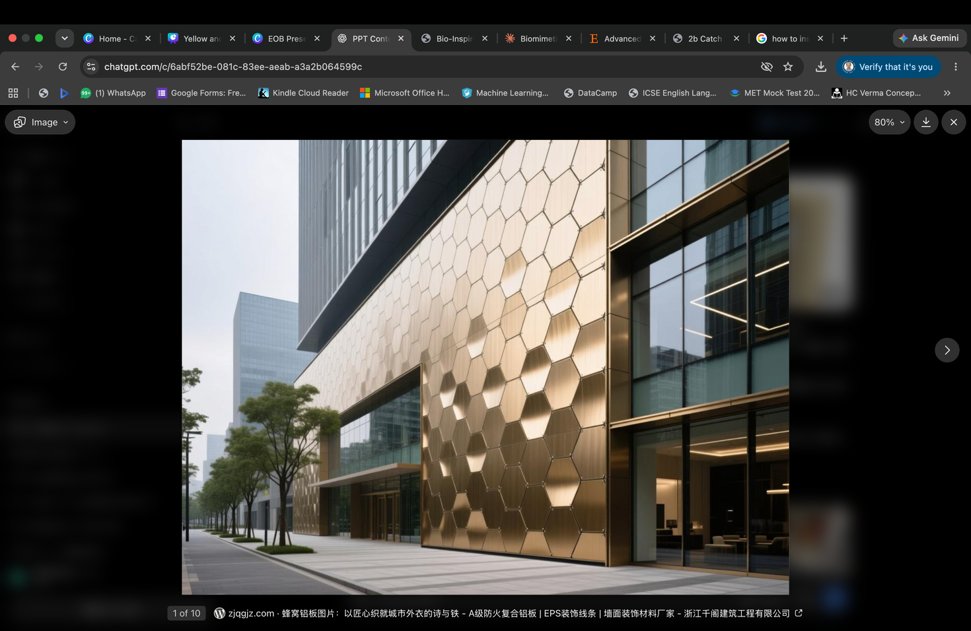
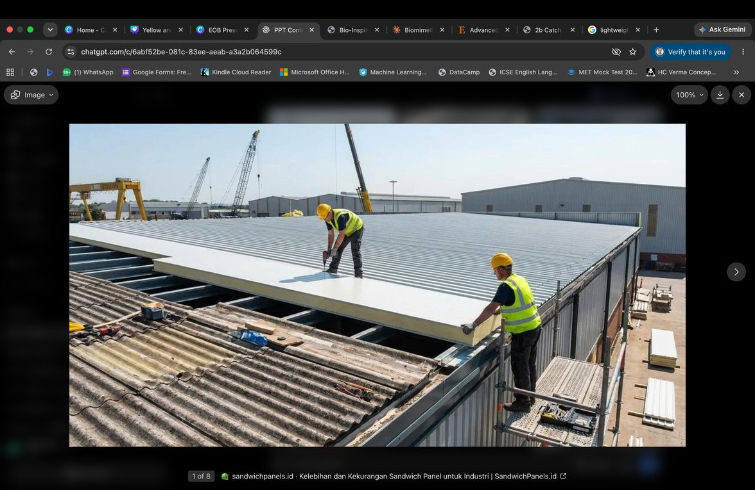
Applications
In Construction:
1. Building Walls and Façade Panels
The cellular core supports the outer sheets and helps the panel resist bending while keeping it relatively lightweight.
Structural significance: Improves panel rigidity and reduces the load imposed on the building frame.
2. Lightweight Roofing Systems
Their two strong outer sheets are separated by a lightweight cellular core, which increases bending stiffness without requiring a solid, heavy panel.
Structural significance: Reduces the dead load transferred to beams, columns and foundations.

Slide 10
Applications

Slide 11
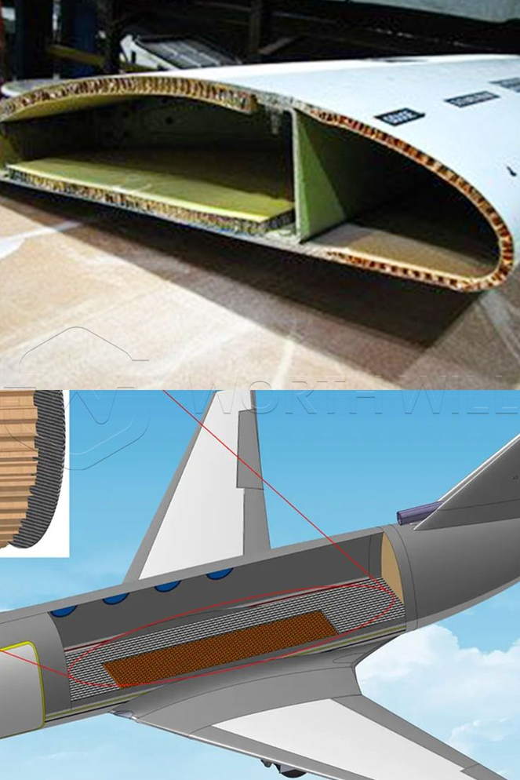
Applications
In Aircrafts:
The aerospace industry relies heavily on industrial honeycomb structures for manufacturing aircraft parts. Components like wings, fuselages, and engine nacelles use honeycomb cores made of metals or composites. These cores are lightweight yet strong enough to endure extreme pressure and temperature changes.
One such use of honeycomb structure in airplanes is:
Composite Honeycomb Panels: Used in airplane floors to reduce weight while maintaining structural integrity.

Slide 12
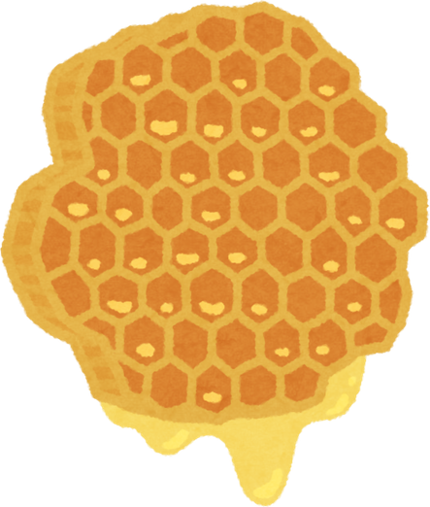

PROs
Why do Honeycomb Structures Work?
1.
Lightweight Construction
2.
Material Efficiency
3.
Energy Absorption
Honeycomb structures have low density while maintaining useful stiffness and strength.
The cellular geometry means less material can be used to create a structural component with useful mechanical performance.
Honeycomb structures can deform progressively and absorb mechanical energy.
4.
5.
Structural Stability
Design Flexibility
6.
Potential for Sustainable Design
Honeycomb configurations can improve stability and distribute loads.
Modern designs can use:
  Hierarchical cells
  Graded cells
  Reinforced cells
  Hybrid geometries
Reducing structural mass can potentially reduce material use and transportation loads.

Slide 13
CONS
1. Manufacturing complexity
Complex cellular and hierarchical geometries can require advanced manufacturing.
2. Direction-dependent behaviour
Honeycomb performance can vary depending on the direction and type of loading.
3. Local damage
Damage to individual cells can affect the overall structural response.
4. Scaling
A design that works well at laboratory scale cannot automatically be assumed to work the same way in a full-sized building.

Slide 14
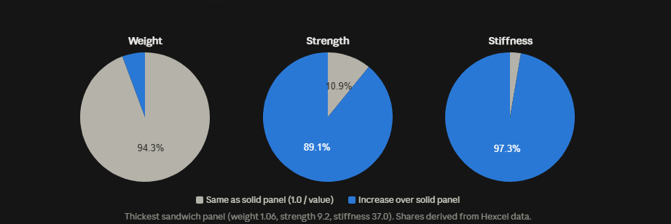
Statistical Data
Honeycomb structure vs solid structure
The pies show how little extra weight the honeycomb core adds compared with what it gains. For the thickest sandwich panel, only 5.7% of its weight is added over a solid panel. The same core supplies 89.1% of its strength and 97.3% of its stiffness. The 2.7% slice in the stiffness pie is too small to carry its label, so it only appears in the tooltip.

Slide 15
Research Timeline
1982-1983
1999-2001
2021-2025
Mechanics of cells
Conjecture proved
Advanced & printed designs
Gibson & Ashby model 2D honeycombs: properties follow cell-wall material & cell geometry
Hales proves hexagons give the least perimeter for equal areas
Reviews map hierarchical, graded and hybrid cells; 3D printing tests hexagon, triangle, square, rectangle and double-V cells under identical conditions
1997
2012
Energy absorption data
Hierarchical honyecombs
Axial crush tests on 6 honeycomb types: dynamic crush strength up ton 74% highe than quasi static
Replacing each vertex with a smaller hexagon gives up to 2x and 3.5x the stiffness at the same mass

Slide 16
Future Possibilities
Honeycomb: Future Possibilities in Architecture
  Reconfigurable Cells: Structures that change stiffness when needed.
  Self Sensing Panels: Walls that detect internal damage.
  Custom Printed Cells: Different cell sizes for different building loads.
  Climate Adaptive Facades: Panels that respond to changing temperatures.
  Earthquake Responsive Cores: Structures designed to absorb seismic energy and limit damage.

Slide 17
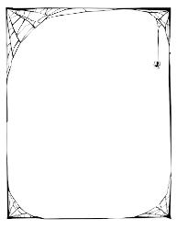
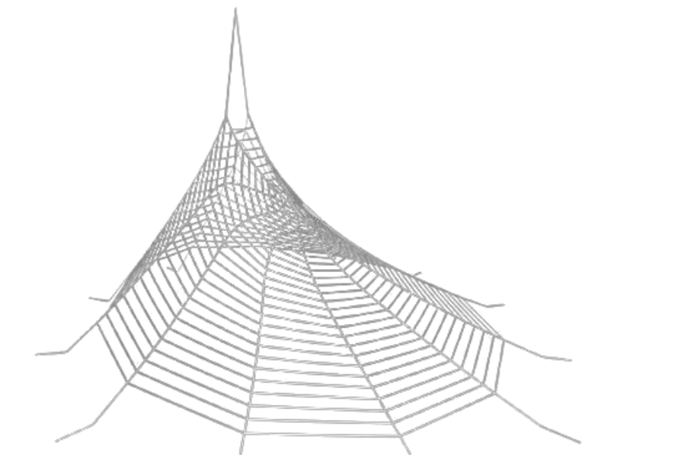
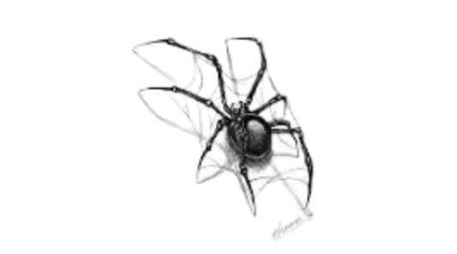
SPIDER WEB DESIGNS

Slide 18
Problem Statement
The engineering challenge :
NATURE SOLVED THIS ALREADY
Modern construction and manufacturing constantly struggle to balance strength, weight and material cost. Over-built structures waste material, add cost and increase the carbon footprint. Under-built ones fail under load, wind or impact.
Spiders face the same constraints as engineers: limited energy, limited raw material (protein) and real structural loads such as wind and prey impact.
Can we design structures that are:
  Lightweight, yet able to bear heavy or dynamic loads
  Material- and cost-efficient
  Resilient to impact, vibration, wind and seismic force
  Scalable — from a packaging box to a stadium roof
  Sustainable, using less energy and raw material
Their solution, refined over millions of years, is now a direct blueprint for tensile roofs, building facades and lightweight materials.

Slide 19

The Scale of the Challenge
Questions to ask:
  34% of global CO₂ emissions come from buildings and construction
  32% of global energy use goes to the buildings sector
  18% of global emissions come from cement & steel production
  ⅓ of global waste comes from buildings and construction
Objective: Explain
How does a web carry and spread load using so little material?
Objective: Compare
How do webs differ from conventional rigid structures?
Using less material for the same strength cuts cost, carbon and waste together — exactly what a spider web does.
Objective: Evaluate
Can web geometry scale into real buildings, and how does AI help design it?
Structures that copy spider-web geometry can match conventional strength while using noticeably less material.

Slide 20
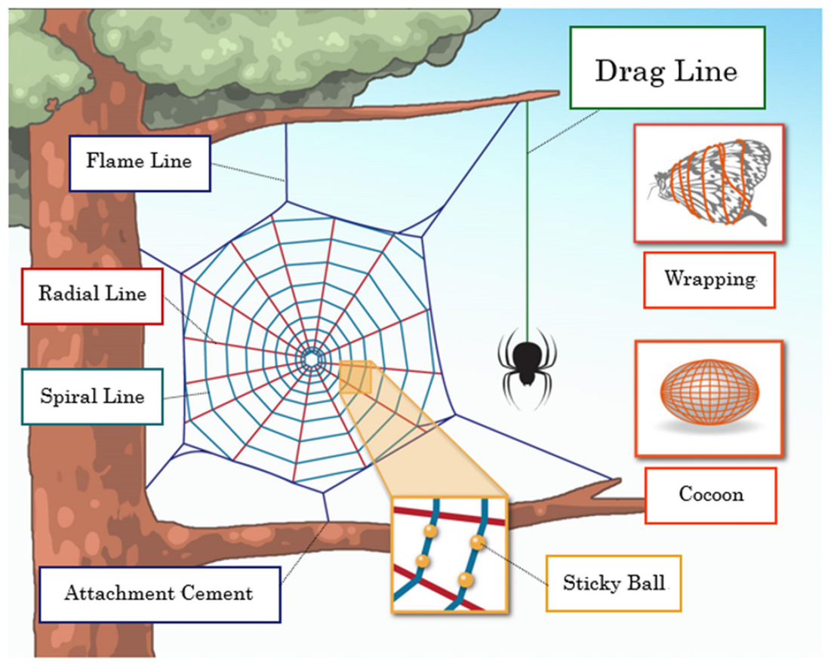
Biological phenomenon
Spider Web Architecture and Load Distribution
•Radial Threads: Strong supporting threads extend outward from the centre and carry much of the load applied to the web.
•Spiral Threads: Connecting threads link the radial framework and help capture prey while maintaining the web's structure.
•Network Connectivity: Interconnected threads allow forces to travel across different parts of the web instead of remaining at one point.
•Structural Efficiency: The open network provides useful strength and flexibility while using very little material.

Slide 21
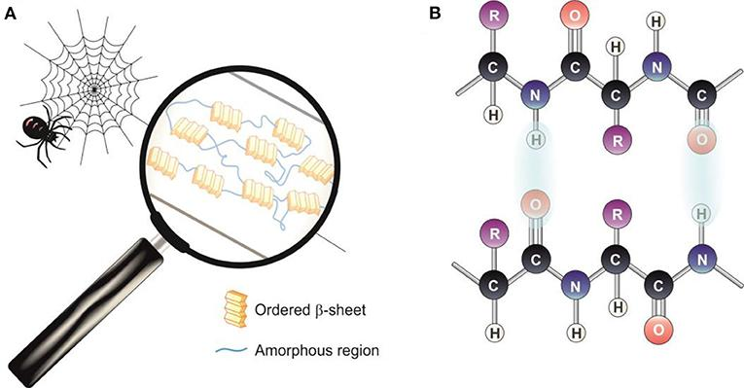
Biological phenomenon
Spider Silk: Molecular Structure and Properties
•Protein Composition: Spider silk is mainly made from proteins called spidroins, which determine many of its mechanical properties.
•Beta Sheet Nanocrystals: These ordered protein regions help the silk resist deformation and provide strength.
•Amorphous Regions: Less ordered protein regions allow the fibres to stretch and absorb mechanical energy.
•Combined Properties: The molecular arrangement balances strength, flexibility, and energy absorption within a lightweight fibre.

Slide 22
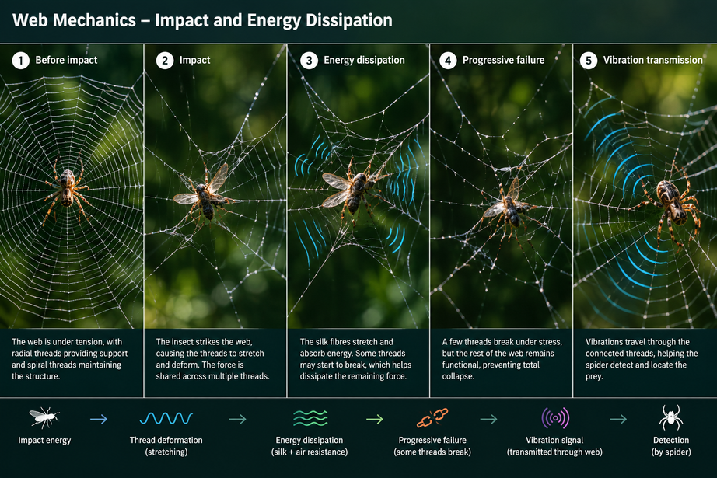
Biological phenomenon
Web Mechanics: Impact and Energy Dissipation
•Fibre Stretching: Threads stretch and deform when an insect strikes the web, helping manage the impact.
•Energy Dissipation: Silk deformation and aerodynamic effects help reduce the energy transferred during prey impact.
•Progressive Failure: Some threads may break under stress without immediately causing the entire web to collapse.
•Vibration Transmission: Vibrations travel through the connected threads, allowing spiders to detect movement and locate prey.

Slide 24
Applications
Bioinspired energy-absorbing structures have found widespread applications in fields like:
  Architecture
  Mechanical engineering
  Automotive Engineering

Slide 25
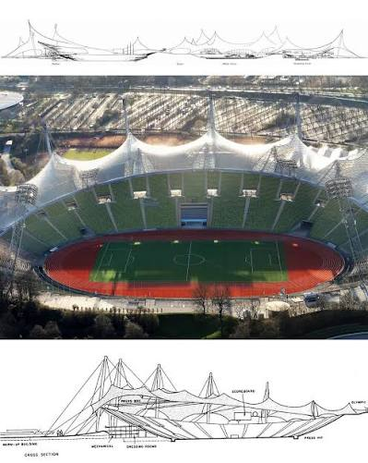
Why use Spider -Web inspired Structural Engineering?
  Tensile-Driven Geometry: A spider web is a tension-based structure, much like cable nets or suspension bridges. The load is carried primarily through tension, allowing for minimal material use while maintaining structural integrity
  Redundancy and Damage Tolerance: When one strand of the web breaks, the rest of the system can redistribute the load, preventing catastrophic failure—a concept increasingly used in earthquake-resistant design.
  Form-Finding Through Function: Spiders instinctively build their webs based on environmental conditions. Similarly, engineers use form-finding techniques like dynamic relaxation and optimization algorithms to determine efficient structural forms.
  Lightweight Yet Strong: Spider silk is stronger than steel by weight. While we don’t yet have industrial equivalents, the principle of maximizing strength while minimizing mass is a key goal in structural engineering.
Munich Olympic Stadium-1972
Frei Otto's cable-net roof showed how web-like tension can be scaled into architecture.

Slide 26
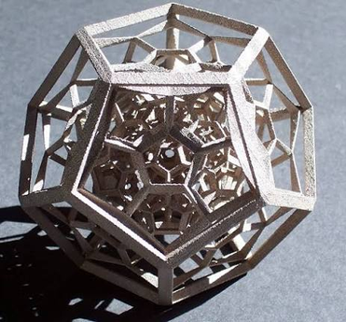
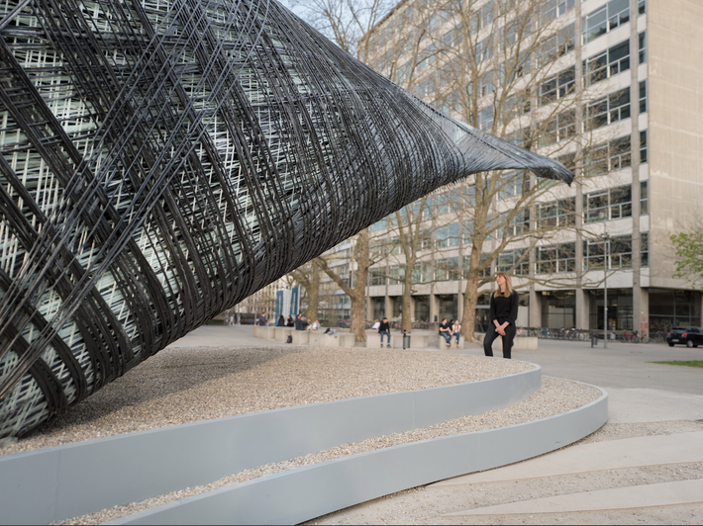
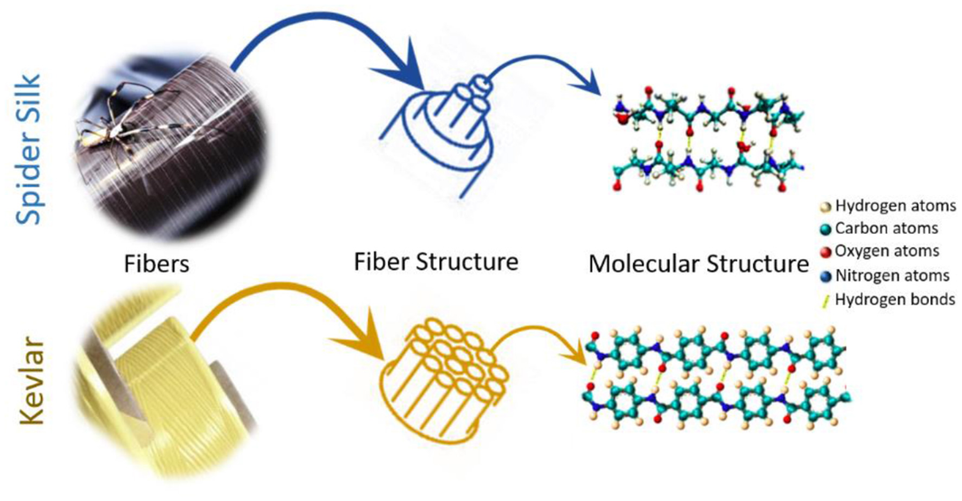
Materials & Manufacturing
Spider-silk composites
3D-printed web lattices
Robotic silk-inspired fabrication
Light, strong materials for future buildings. Lab-made 'wrinkled' silk fibres have reached 1.61 GPa tensile strength (2025).
MIT researchers design synthetic webs, 3D-print them and test them; generative AI models (2023) now propose new web geometries.
MIT Media Lab's CNSilk project explores robotic fabrication inspired by how silk is spun.

Slide 27
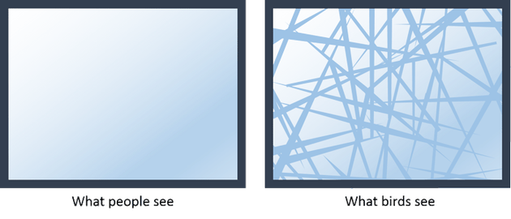
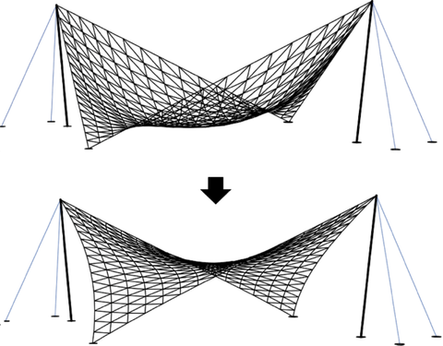
Safety, Sensing & Smart Design
  Earthquake resistant design
  Redundant load paths let a structure redistribute force if one member fails.
2.Form finding algorithms
  Dynamic relaxation and optimisation find efficient tension-structure shapes, as spiders do instinctively.
3.bird safe glass
  'Spiderweb glass' uses UV-reflective web patterns that birds can see, reducing collisions.
4.smart sensing cables
  Idea under study: cables that sense vibration changes could give early warning of damage.
bird safe glass
Form finding algorithms

Slide 28
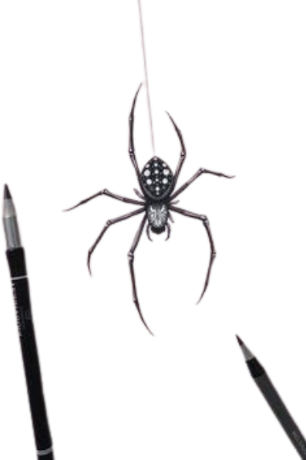
PROs
1.
2.
3.
Tension-based efficiency
Multiple load paths
Damage tolerance
Carries load mainly in tension, so minimal material is needed.
Forces spread through the web network instead of one member.
If a strand breaks, the rest can redistribute the load.
4.
5.
6.
Flexible, not rigid
Absorbs and dissipates energy
Inspires hierarchical lattices
Can move and adapt rather than resist everything stiffly.
Mechanical energy from impacts and vibration is spread out.
Web logic guides new lightweight lattice and cable-net designs.

Slide 29
CONs
Limitations & How Research Responds
LIMITATIONS | WHY IT MATTERS | RESPONSE
Complex geometry | Replicating web-like structures accurately is difficult. | Parametric design and 3D printing.
Optimisation required | Small changes in web geometry can change mechanical performance. | Generative AI and simulation to search designs.
Manufacturing limits | Highly complex geometries are hard to build conventionally. | Additive manufacturing (3D printing).
Limited large-scale evidence | Most research covers materials, lattices and components, not whole buildings. | Scaled testing and pilot structures.

Slide 30
Research Timeline
Early Research — Understanding Natural Webs (1995–2016)
1995-Structural Mechanics
Early 2000s-2010s-Material and Network Studies
Researchers modelled spider-web silk properties and showed the importance of aerodynamic damping in prey capture.
Research increasingly examined silk mechanics, web geometry, vibration, and load distribution.
Research Goal: Understand how web structure and silk properties work together.
Key Development: Spider webs became models for studying efficient, lightweight, energy-absorbing structures.

Slide 31
Research Timeline
Adaptive and Bio-Inspired Designs (2017–2022)
2017-Adaptive Webs
2021-3D Web Mechanics
2022-Prey Detection
Researchers tested adjustable radial-thread tension to improve energy absorption and compensate for damaged threads.
Researchers studied how a spider builds a three-dimensional web and how its geometry develops.
Models investigated how web mechanics and silk properties help identify the location of an impact.
Key Development: Research moved from understanding natural webs towards controllable structures and sensing applications.

Slide 32
Research Timeline
Recent Advances - Artificial Spider-Web Structures (2024–2026)
2024-Sensitive Web-Inspired Sensors
2025–2026-Energy Absorption
2026-Artificial Web Sensors
Researchers developed a spider-web-inspired material for detecting airflow and sound.
Studies investigated printed spider-web structures designed to withstand compression and absorb energy.
Research demonstrated multiscale artificial webs for pressure sensing and human–machine interaction.
Current Direction: Research focuses on manufacturable structures, advanced sensing, and improved mechanical performance.

Slide 33
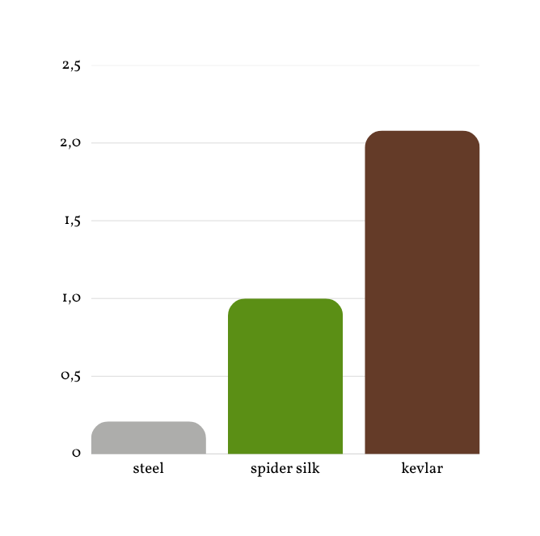
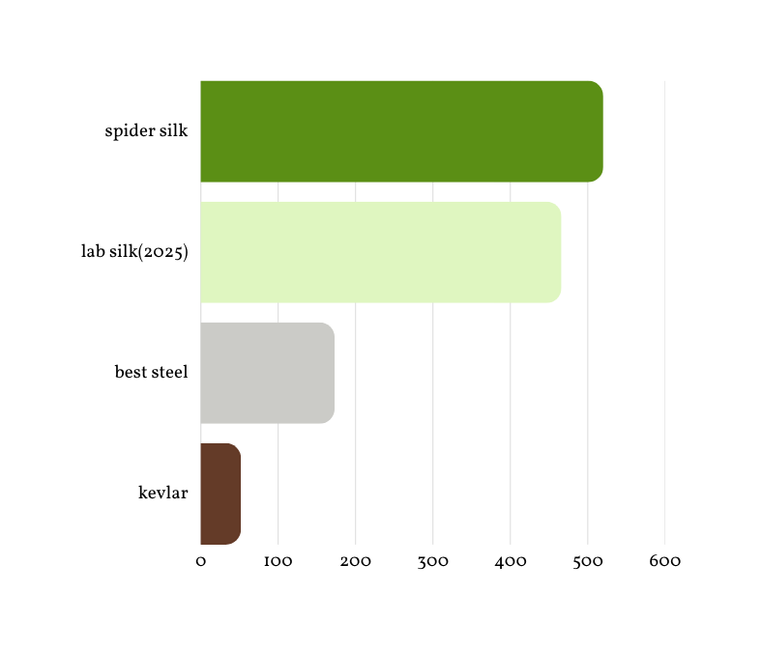
Statistical Data
Specific strength: tensile strength ÷ density (higher = stronger per unit weight)
Toughness: energy absorbed before failure (MJ/m³)
per unit weight steel is far behind silk, and silk's real advantage is toughness, about 3× the strongest steels. Kevlar is stronger per weight but much less tough.

Slide 34
Summary
Key Biological Principles
• Efficient Geometry: Radial and spiral threads form a connected network that supports the web and distributes forces.
• Material Performance: Spider silk combines strength with flexibility, allowing it to withstand different types of mechanical stress.
• Force Distribution: Connected threads transfer loads between different parts of the web, helping it respond to external forces.
• Energy Absorption: Silk fibres stretch and deform under impact, helping dissipate energy before complete structural failure.
• Sensory Function: Vibrations travel through the web and provide information about movement and the location of prey.
Main Finding: Spider-web performance depends on the interaction between its geometry, material properties, and connected network.

Slide 35
Summary
Engineering Lessons from Spider Webs
• Lightweight Design: Efficiently arranged networks can reduce unnecessary material while maintaining useful structural performance.
• Damage Tolerance: Connected systems with alternative load paths may continue functioning after some local connections fail.
• Adaptive Performance: Adjustable cable tension can change how a structure responds to different loads and environmental conditions.
• Structural Monitoring: Web-inspired sensing networks could identify unusual vibrations and help detect possible damage.
• Material Innovation: Spider-silk-inspired fibres may lead to lightweight components with useful strength and flexibility.

Slide 36
Summary
Current Applications and Limitations
• Existing Research Uses: Spider-web principles are being explored in experimental lattices, sensing devices, and bio-inspired materials.
• Architectural Potential: Related principles of tension and network connectivity already appear in cable roofs and tensile structures.
• Manufacturing Challenges: Producing artificial spider silk and complex interconnected networks at large scale can be expensive.
• Safety Requirements: Building applications require extensive testing for durability, weather resistance, and structural reliability.
• Implementation Gap: Many direct spider-web-inspired construction concepts remain at the research or prototype stage.
Conclusion: Spider webs offer valuable design principles, but each engineering application must be tested for practical use.

Slide 37
Future Possibilities
Adaptive Structures and Smart Buildings
• Adaptive Cable Networks: Cables could adjust tension in response to changing loads and wind conditions.
• Smart Structural Monitoring: Connected sensors could detect unusual vibrations and identify possible damage early.
• Self-Healing Connections: Advanced materials or replaceable links could help structures recover from minor damage.
• Lightweight Materials: Artificial spider-silk fibres could support strong, flexible, and lightweight construction components.
• Sustainable Construction: Optimised web-like networks could reduce material use while maintaining structural performance.

Slide 38
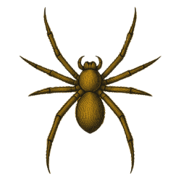
Thank You

